Slide 1

Unit-3 NoSQL
Big Data Analytics(BDA)
GTU #3170722
Prof. Maulik D. Trivedi
Computer Engineering Department
maulik.trivedi@darshan.ac.in
9998 265 805

Slide 2

Looping
Outline
What is NoSQL?
NoSQL Business Drivers
NoSQL Case Studies
NoSQL Data Architecture Patterns (Types of NoSQL DB)
Key-value Oriented
Graph Oriented
Column Oriented
Document Oriented
Using NoSQL to Manage Big Data
What is a big data NoSQL solution?
Understanding the types of big data problems
Four ways that NoSQL systems handle big data problems

Slide 3
What is NoSQL?

Slide 4
What is NoSQL?
NoSQL (commonly known as "Not Just SQL") represents a completely different database framework that can achieve high-performance and agile processing of large-scale information.
In other words, it is a database infrastructure, very suitable for the huge needs of big data.
The efficiency of NoSQL can be achieved because, unlike highly structured relational databases, NoSQL databases are inherently unstructured, which makes up for the strict consistency requirements for speed and agility.
NoSQL focuses on the concept of distributed databases, where unstructured data can be stored on multiple processing nodes, and usually on multiple servers.
This distributed architecture allows NoSQL databases to scale horizontally; as the data continues to grow, just add more hardware to keep up without reducing performance.
NoSQL Distributed Database Infrastructure has always been a solution for handling some of the largest data warehouses on the planet, such as Google, Amazon, and the Central Intelligence Agency.

Slide 5
Where is NoSQL used?
NoSQL databases are widely used in big data and other real-time web applications.
NoSQL databases is used to stock log data which can then be pulled for analysis. Likewise, it is used to store social media data and all such data which cannot be stored and analyzed comfortably in RDBMS.
Where to used NoSQL?
Log Analysis
Social Networking Feeds
Time based data
NoSQL
Non-relational data storage systems
No fixed table schema
No joins
No multi-document transactions
Relaxes one or more ACID properties

Slide 6
Features & Advantages of NoSQL
Few features of NoSQL databases are as follows:
They are open source.
They are non-relational.
They are distributed.
They are schema-less.
They are cluster friendly.
They are born out of 21st century web applications.
NoSQL databases provide various important advantages over traditional relational databases.
A few core features of NoSQL are listed here, which apply to most NoSQL databases.

Slide 7
Advantages of NoSQL Database
Schema Agnostic
NoSQL databases are schema agnostic.
Easy to designing your schema before you can store data in NoSQL databases.
You can start coding, and store and retrieve data without knowing how the database stores and works internally.
Schema agnosticism may be the most significant difference between NoSQL and relational databases.
Scalability
NoSQL databases support horizontal scaling methodology that makes it easy to add or reduce capacity quickly without tinkering with commodity hardware.
This eliminates the tremendous cost and complexity of manual sharing that is necessary when attempting to scale RDBMS.

Slide 8
Advantages of NoSQL Database – Cont.
Performance
Some databases are designed to operate best (or only) with specialized storage and processing hardware.
With a NoSQL database, you can increase performance by simply adding cheaper servers, called commodity servers.
This helps organizations to continue to deliver reliably fast user experiences with a predictable return on investment for adding resources again, without the overhead associated with manual sharing.
High Availability
NoSQL databases are generally designed to ensure high availability and avoid the complexity that comes with a typical RDBMS architecture, which relies on primary and secondary nodes.
Some ‘distributed’ NoSQL databases use a masterless architecture that automatically distributes data equally among multiple resources so that the application remains available for both read and write operations, even when one node fails.

Slide 9
NoSQL Business Drivers

Slide 10
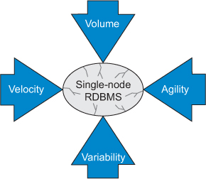
NoSQL Business Driver
The demands of volume, velocity, variability, and agility play a key role in the emergence of NoSQL solutions.
As each of these drivers applies pressure to the single-processor relational model, its foundation becomes less stable and in time no longer meets the organization’s needs.
The business driver's volume, velocity, variability, and agility apply pressure to the single CPU system, resulting in the failures.
Volume and velocity refer to the ability to handle large datasets that arrive quickly.
Variability refers to how diverse data types don’t fit into structured tables.
Agility refers to how quickly an organization responds to business change.

Slide 11
NoSQL Business Driver - Volume
The key factor that led organizations to seek alternatives to their current RDBMS was the need to use commodity processor clusters to query big data.
Early 2005 that performance problems were solved by buying faster processors.
Over time, the ability to increase processing speed is no longer an option. As chip density increases, heat cannot be quickly dissipated if chips are overheated.
This phenomenon, known as the power wall, forces system designers to shift their attention from increasing the speed of a single chip to using more processors to work together.
The need for horizontal scaling instead of vertical scaling (faster processors) shifts the organization from serial processing to parallel processing, where data problems are broken down into separate paths and sent to separate processors to divide and conquer.

Slide 12
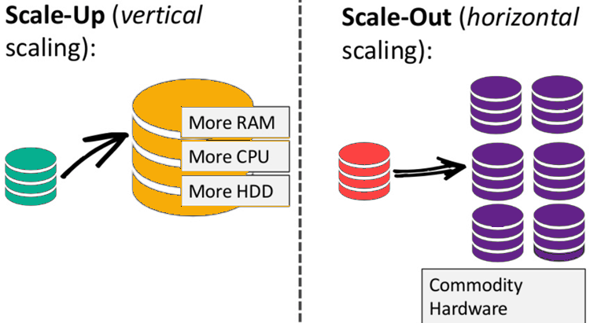
NoSQL Business Driver - Volume

Slide 13
NoSQL Business Driver - Velocity
A big data issues are a consideration for many organizations far from RDBMS, the ability of uniprocessor systems to quickly read and write data is also critical.
Many single-processor RDBMSs cannot meet the real-time insertion and online database query needs of public websites.
RDBMS often indexes many columns in each new row, a process that reduces system performance.
When a single-processor RDBMS is used as the back end of a web store front end, random bursts in web traffic will slow down everyone's response speed, and the cost of adjusting these systems when high read and write performance is required can be high.

Slide 14
NoSQL Business Driver - Variability
An Organizations that want to capture and report abnormal data will encounter difficulties when trying to use the strict database schema structure enforced by the RDBMS.
For example, if a business unit wants to capture some custom fields for a specific customer, all customer rows in the database must store this information, even if it is not applicable.
Adding a new column to the RDBMS requires shutting down the system and executing the ALTER TABLE command.
When the database is large, this process affects the availability of the system, which consumes time and money.

Slide 15
NoSQL Business Driver - Agility
The most complex part of creating an application with RDBMS is the process of entering and extracting data from the database.
If your data has nested and repeated data structure subgroups, you must include an object-relational mapping layer.
The responsibility of this layer is to generate the correct combination of SQL INSERT, UPDATE, DELETE, and SELECT statements to move object data in and out of the RDBMS persistence layer.
This process is not simple. When developing new applications or modifying existing applications, it is the biggest obstacle to rapid change.
Object-relational mapping usually requires object-relational frameworks such as Java Hibernate (or NHibernate for .Net systems).

Slide 16
NoSQL Case Studies

Slide 17
NoSQL Case Studies
LiveJournal’s Memcache
Google’s MapReduce
Google’s Bigtable
Amazon’s Dynamo

Slide 18
NoSQL Data Architecture Patterns
(Types of NoSQL Database)

Slide 19
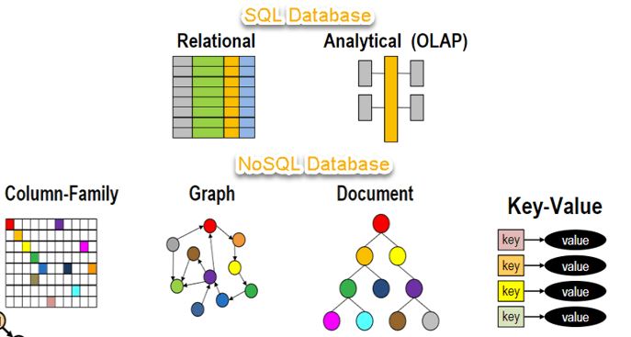
Types of NoSQL
Traditional RDBMS uses SQL syntax to store and retrieve data from SQL databases.
They all use a data model that has a different structure than the traditional row-and-column table model used with relational database management systems (RDBMSs).
Instead, a NoSQL database system encompasses a wide range of database technologies that can store structured, semi-structured, unstructured and polymorphic data.
Key-Value Pair Oriented
Document Oriented
Column Oriented
Graph Oriented

Slide 20
Key-Value Pair Oriented
Key-value Stores are the simplest type of NoSQL database.
Data is stored in key/value pairs.
It uses keys and values to store the data. The attribute name is stored in ‘key’, whereas the values corresponding to that key will be held in ‘value’.
In Key-value store databases, the key can only be string, whereas the value can store string, JSON, XML, Blob, etc. Due to its behavior, it is capable of handling massive data and loads.
The use case of key-value stores mainly stores user preferences, user profiles, shopping carts, etc.
DynamoDB, Riak, Redis are a few famous examples of Key-value store NoSQL databases.
Key | Value
First Name | Rahul
Last Name | Mehta

Slide 21
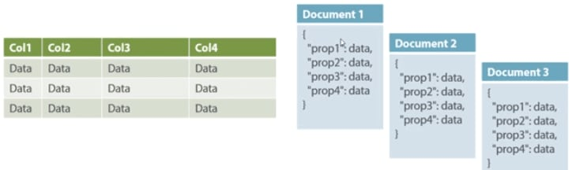
Document Oriented
Document Databases use key-value pairs to store and retrieve data from the documents.
A document is stored in the form of XML and JSON.
Data is stored as a value. Its associated key is the unique identifier for that value.
The difference is that, in a document database, the value contains structured or semi-structured data.
This structured/semi-structured value is referred to as a document and can be in XML, JSON or
BSON format.
Examples of Document databases are – MongoDB, OrientDB, Apache CouchDB, IBM Cloudant, CrateDB, BaseX, and many more.

Slide 22
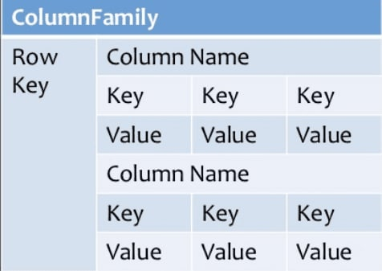
Column-Oriented
Column-oriented databases work on columns and are based on BigTable paper by Google.
Every column is treated separately. Values of single column databases are stored contiguously.
They deliver high performance on aggregation queries like SUM, COUNT, AVG, MIN etc. as the data is readily available in a column.
Column-based NoSQL databases are widely used to manage data warehouses, business intelligence, CRM, Library card catalogs,
HBase, Cassandra, HBase, Hypertable are NoSQL query examples of column based database.

Slide 23
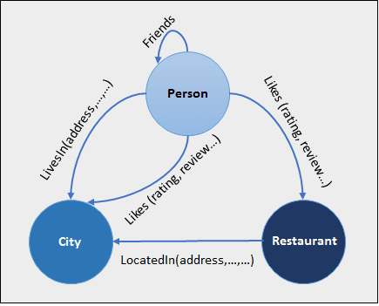
Graph Oriented
Graph databases form and store the relationship of the data.
Each element/data is stored in a node, and that node is linked to another data/element.
A typical example for Graph database use cases is Facebook.
It holds the relationship between each user and their further connections.
Graph databases help search the connections between data elements and link one part to various parts directly or indirectly.
The Graph database can be used in social media, fraud detection, and knowledge graphs. Examples of Graph Databases are – Neo4J, Infinite Graph, OrientDB, FlockDB, etc.

Slide 24
NoSQL @Glance
NoSQL database is optimum for processing massive volume data with distributed processing.
NoSQL database supports failover mechanisms and ensures high availability.
NoSQL database provides easy replication along with horizontally scalable capability.
NoSQL database is capable of handling structured, semi-structured, and unstructured data.
NoSQL databases can be installed on commodity hardware and can form clusters for distributed processing.
NoSQL database offers flexible schema and can be changed at runtime without service downtime.

Slide 25
Using NoSQL to Manage Big Data

Slide 26
Using NoSQL to Manage Big Data
The main reason behind organization moving towards a NoSQL solution and leaving the RDBMS system behind is the requirement to analyze a large volume of data.
It is any business problem which could be so large and single processor cannot manage it.
We need to move single processor environment to distributed computing environment due to big data problem.
It has own problems and challenges while solving big data problems.

Slide 27
Big Data Use-case
Typical big data use-cases:
Bulk Image Processing
Public Web Page Data
Remote Sensor Data
Event Log Data
Mobile Phone Data
Social Media Data
Game Data

Slide 28
Bigdata Use-case Solutions
Scaling linearly with growing data size by becoming an efficient with input and output.
Organizations not able to afford to hire many people to run the server, so becoming operationally efficient.
Not every business can afford a full time java developer to write on demand queries, so its require that reports and analysis be performed by nonprogrammers using simple tools.
Meeting the challenges of distributed computing, with consideration of latency between systems and eventual node failures.
Meeting both the need of overnight batch processing economy of scale and time critical event processing.

Slide 29
Sample Big Data Types Taxonomy
Big Data
Read Mostly
Read - Write
Image
Event Log
Documents
Graph
High Availability
Transactions
Real-Time
Batch
Clickstream
Operational
Full-Text
Simple Text
Annotations

Slide 30
Three Ways to Share Resource
The resources can be shared between computer systems by three ways.
By shared RAM
By shared disk
By share nothing

Slide 31
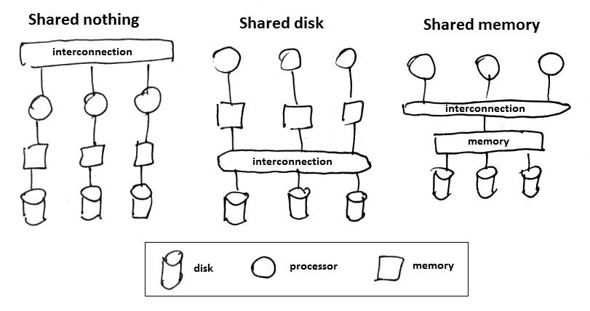
Three Ways to Share Resource

Slide 32
Distributed Model
From a distribution perspective, there are two main models:
Peer-to-Peer Model
Master-Slave Model
Distribution models determine the responsibility for processing data when a request is made.
Peer-to-peer models may be more resilient to failure than master-slave models.
Some master-slave distribution models have single points of failure that might impact your system availability, so you might need to take special care when configuring these systems.
In the master-slave model, one node is in charge (master) rest are slave node.
Using the right distribution model will depend on your business requirements:
If high availability is a concern, a peer-to-peer network might be the best solution.
If you can manage your big data using batch jobs that run in off hours, then the simpler master-slave model might be best.

Slide 33
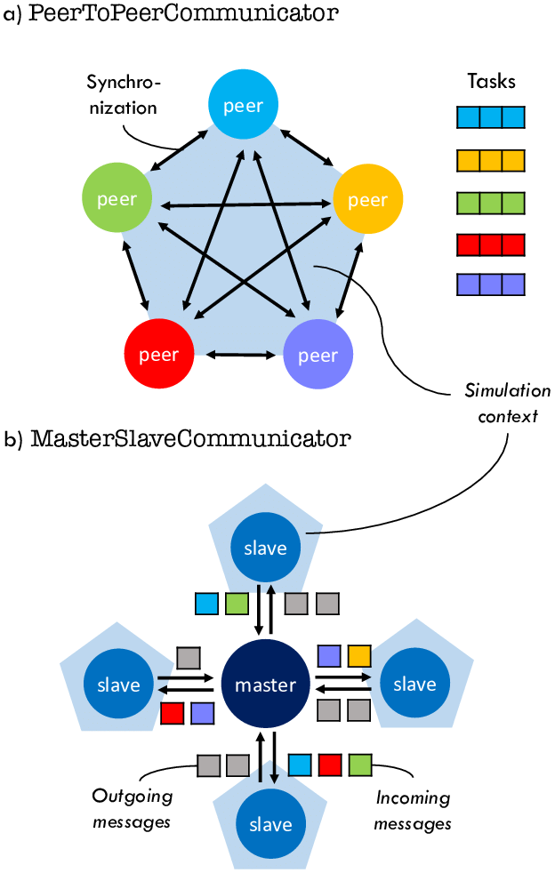
Peer-to-Peer Model
Peer-to-peer systems distribute the responsibility of the master to each node in the cluster.
In this situation, testing is much easier since you can remove any node in the cluster and the other nodes will continue to function.
The disadvantage of peer-to-peer networks is that there’s an increased complexity and communication overhead that must occur for all nodes to be kept up to date with the cluster status.

Slide 34
Master-Slave Model
Hadoop were designed to use a master-slave architecture with the Name-Node of a cluster being responsible for managing the status of the cluster.
Their job is to manage and distribute queries to the correct nodes on the cluster.
Hadoop are also designed to remove single points of failure from a Hadoop cluster.
Slave
Master

Slide 35
Four ways that NoSQL System handle Big Data Problems
Moving Queries to the data, Not Data to the Queries
Using Hash Rings to Evenly Distribute Data on a Cluster
Using Replication to Scale Reads
Letting the Database Distribute Queries Evenly to Data Nodes

Slide 36
SQL Vs. NoSQL
SQL | NoSQL
Relational database | Non-relational, distributed database
Relational model | Model-less approach
Pre-defned schema | Dynamic schema for unstructured data
Table based databases | Document-based or graph-based or wide column store or key–value pairs databases
Vertically scalable (by increasing system resources) | Horizontally scalable (by creating a cluster of commodity machines)
Uses SQL | Uses UnQL (Unstructured Query Language)
Not preferred for large datasets | Largely preferred for large datasets
Not a best ft for hierarchical data | Best ft for hierarchical storage as it follows the key–value pair of storing data similar to JSON (Java Script Object Notation)
Excellent support from vendors | Relies heavily on community support
Supports complex querying and data keeping needs | Does not have good support for complex querying
Can be confgured for strong consistency | Few support strong consistency (e.g., MongoDB), some others can be confgured for eventual consistency (e.g., Cassandra)
Examples: Oracle, DB2, MySQL, MS SQL, PostgreSQL, etc. | Examples: MongoDB, HBase, Cassandra, Redis, Neo4j, CouchDB, Couchbase, Riak, etc.

Slide 37
Big Data Analytics(BDA)
GTU #3170722
Prof. Maulik D Trivedi
Computer Engineering Department
maulik.trivedi@darshan.ac.in
9998 265 805

